Slide 1
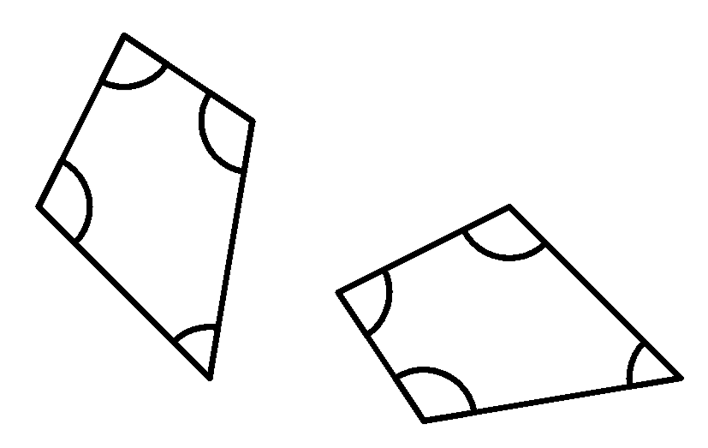
Congruent triangles (SSS)
Task A: Guaranteeing congruence
1) These two quadrilaterals are congruent. Fill in the blanks.
3.6 cm
4.5 cm
83°
114°
83°
108°
55°
3.6 cm
5.7 cm
6.1 cm
2) Give an example of quadrilaterals that show that these conditions are not sufficient to prove congruence.
a) angles are the same
b) angles are the same and in the same order

Slide 2


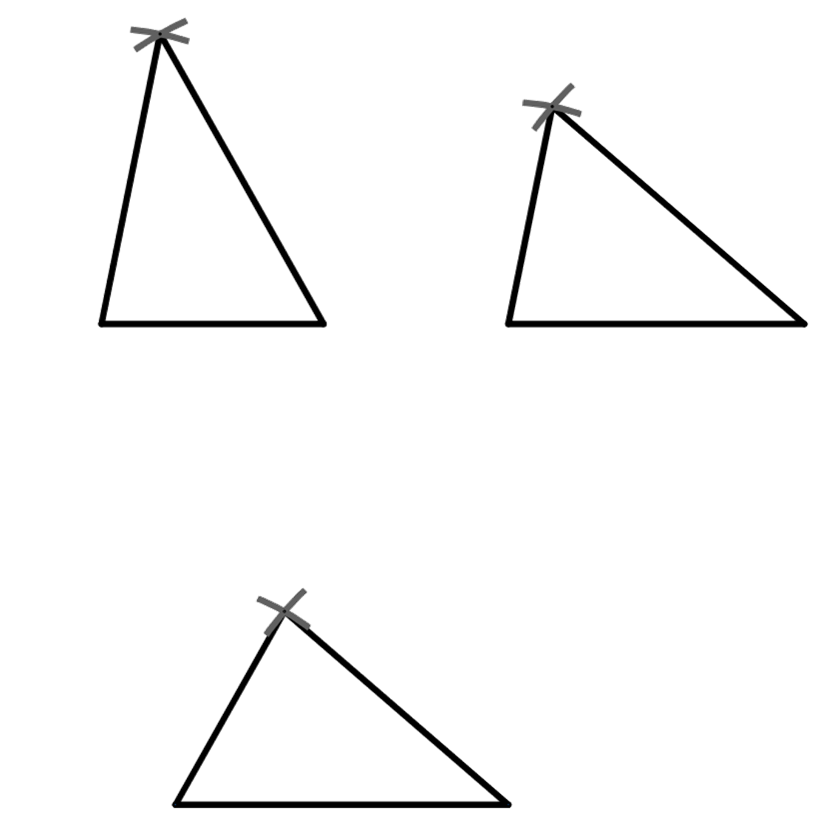
Congruent triangles (SSS)
c) edges are the same length
d) edges are the same length and in the same order
3) The triangle ABC, where AB = x cm, AC = x cm and BC = x cm has been constructed three times,
C
B
A
A
B
A
C
B
C
a) measure the angles ABC, BAC and BCA in each of the three triangles
b) what do you notice?

Slide 3

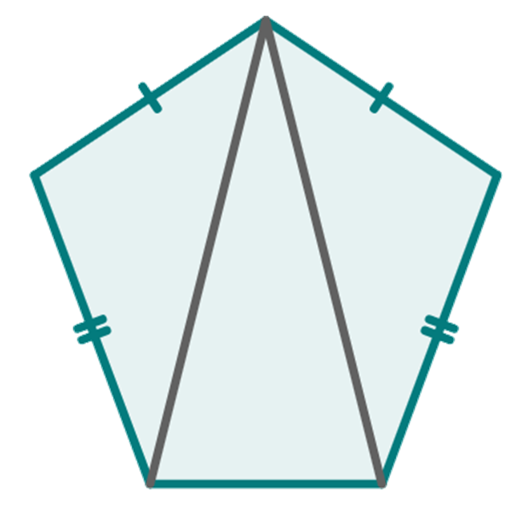
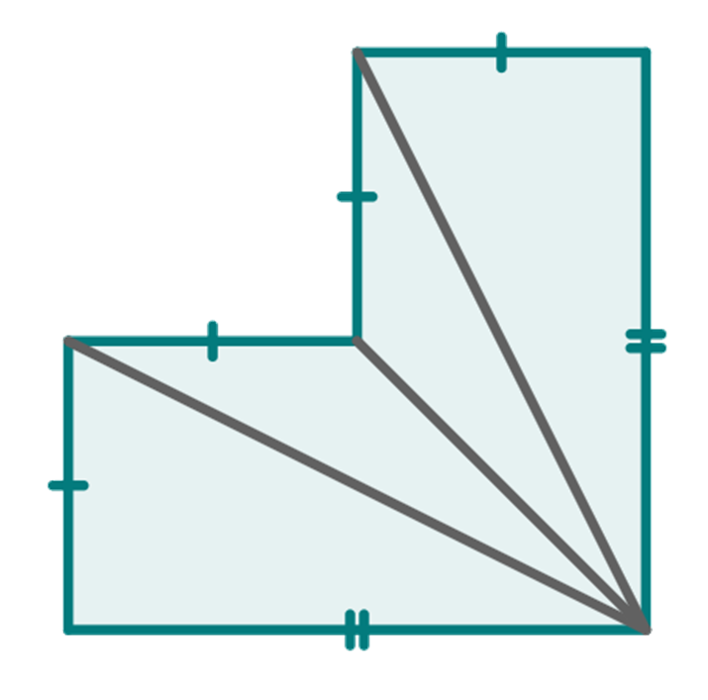
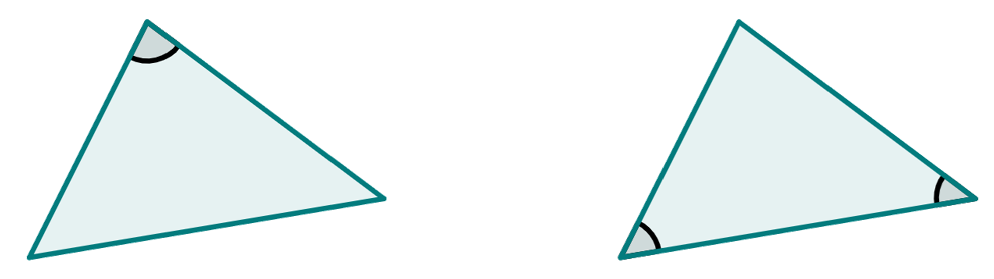
Congruent triangles (SSS)
Task B: Justifying congruence by SSS
1) By measuring the sides of these pair of triangles, decide if they are congruent or not.
A
Z
a)
C
Y
B
X
b)
P
V
R
T
Q
U
2) By using properties of shapes, identify the triangles that are congruent by SSS.
a)
A
b)
T
c)
M
L
D
P
S
I
N
B
Q
R
J
K
C
symmetrical pentagon
symmetrical hexagon
parallelogram
3) These pairs of triangles are congruent. Using this fact, add the edge length marked x.
80°
5 cm
4.5 cm
46°
54°
x cm
6.1 cm
Mathematics in Education and Industry
v2.3

